Slide 1
UKB COVID
GxE Interaction
Analysis
Joanna, Kenny, Magda, Beza
05/19/21

Slide 2
Multiple Risk Factors of COVID-19 Severity
Male sex
Cardiometabolic status (i.e. obesity and T2D)
Social determinants of health
Notes:
These are the risk factors of COVID-19 severity that we have been particularly interested in. Male sex, cardiometabolic status, and social determinants of health - they all have been associated with worse outcomes of COVID.
Male sex is independently associated with higher mortality and worse outcomes (Palaiodimos et al., 2020)
Cardiometabolic status (i.e. obesity and T2D) are associated with increased COVID-19 susceptibility and severity
Social determinants of health: Marginalized communities have disproportionately worse outcomes of COVID-19, likely due to predisposition to worse conditions such as environmental factors, limited healthcare access, and other societal influences

Slide 3
HGI shows genetic architecture of COVID-19 severity
13 genome-wide significant independent loci identified
9 loci associated with increased risk of COVID severity (hospitalization)
Several loci further associated with interstitial lung disease and autoimmune and inflammatory diseases, predisposing individuals to worse outcomes
Body mass index identified as causal risk factor for severe COVID-19
Ganna, A. (2021). Mapping the human genetic architecture of COVID-19 by worldwide meta-analysis. medRxiv, 2021.2003.2010.21252820. doi:10.1101/2021.03.10.21252820
Notes:
Genetic investigations are already underway
Host genetics initiative have demonstrates genes mediate COVID-19 severity through a world-wide meta-analysis
They identified Several loci; effect of loci may be mediated by inflammation; predisposing individuals

Slide 4

Objective
Conduct a genome-wide GxE interaction analysis in the UK Biobank to investigate the interaction between genetic variants and each of sex, obesity, T2D, and social determinants of health in their impact on COVID-19 severity.

Slide 5
Exposures
Genetically-determined sex
Cardiometabolic health: BMI and T2D
  Tested jointly
Social determinants of health: Multiple Deprivation Index (MDI)
  Metrics include: economic stability, physical environment, education
  Individuals from England
Notes:
Cardiometabolic BMI and T2D jointly tested together
Individuals from england to account for heterogeneity across countries in UK
Note: existing definition derived from the Florez lab UKB project
Note: lightning talk - take out individuals from england.

Slide 6
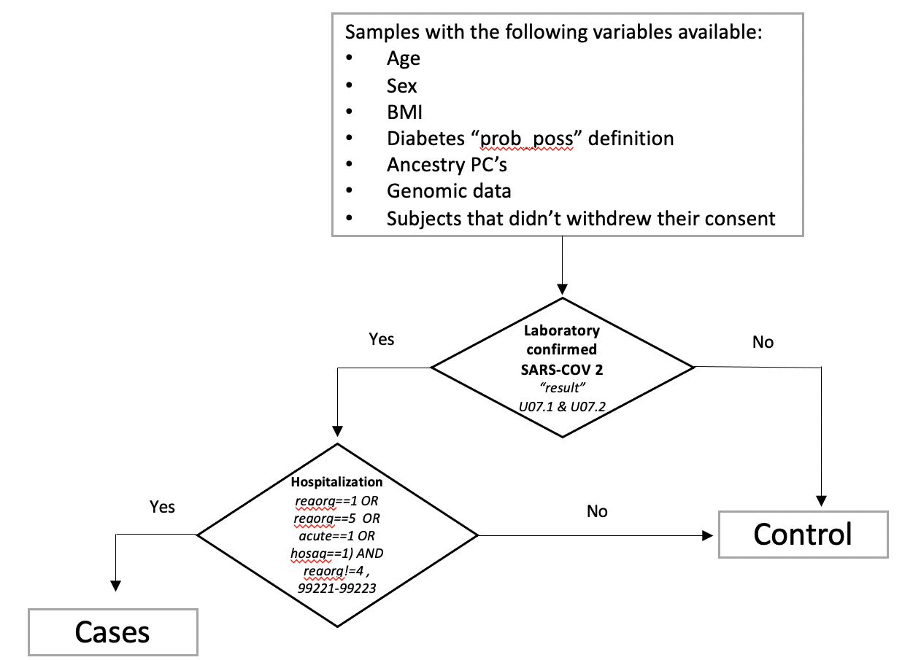
Severe COVID-19: Based on HGI “B2” Phenotype (Hospitalized COVID vs Population)
Notes:
Our defined outcome was laboratory confirmed SARS-CoV-2 and hospitalization

Slide 7
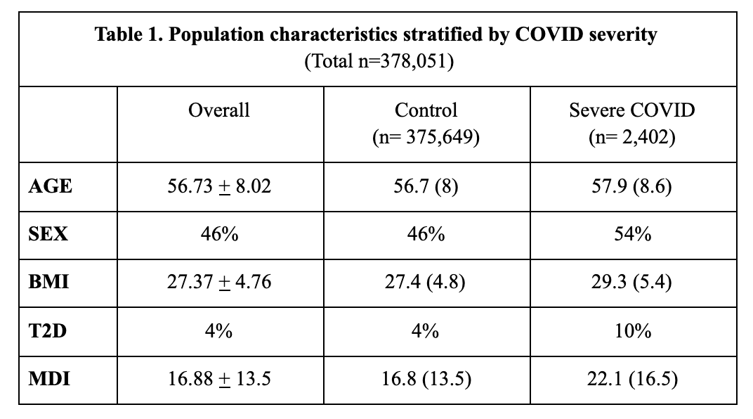
Dataset
Notes:
Population: All unrelated individuals in UKB (that haven’t revoked consent) of European descent
Our Sample size was a quarter of the size of case counts to HGI; substantially lower but we were interested to see what we could find in this dataset
HGI European “B2” phenotype cases = 8315; control = 1,549,095
Case of severe covid defined as an individual with confirmed laboratory SARS-CoV-2 and hospitalization
controls included the rest of the sample.
Sex = overall 46% male. Larger sample = female, Cases tended to be more male, and prevalence of T2D and values of BMI and MDI were higher in cases
Genotypes: Largely rely on the processing already performed by the UKB group
Common variants (MAF > 0.05)
Coded as dosages

Slide 8
Methods
Linear model
y (COVID-19 hospitalization) ~ g + exposure + g*exposure + age + sex + 5 genetic PCs
Statistical tests
Interaction test
Joint test of genetic main and interaction effect
Computational environment
Analysis conducted using GEM
Analysis run on Terra
Variant Investigation
Databases: dbSNP, PhenoScanner, RegulomeDB, LDLink tools
Notes:
Computational environment (optional)

Slide 9
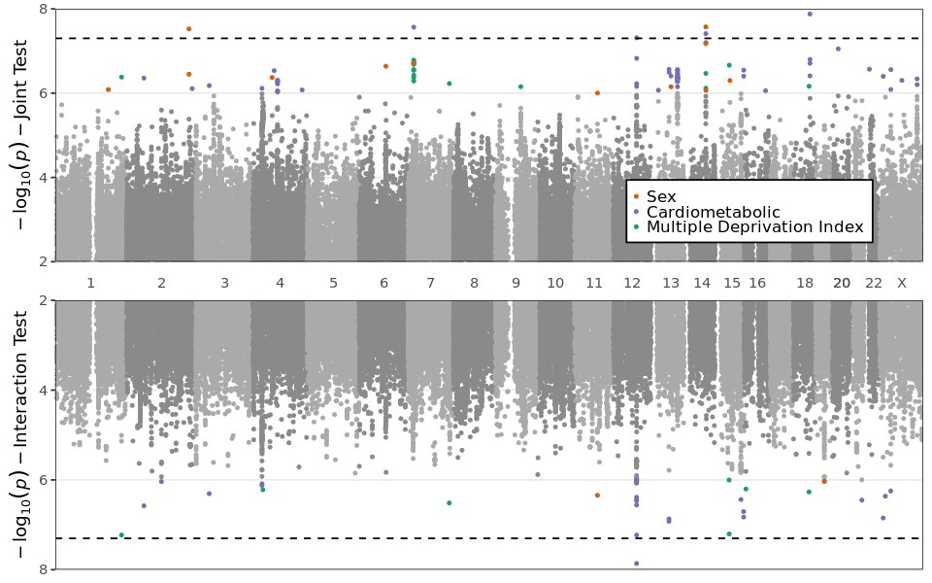
Chr2:218260234
DIRC
Rs182113773
MACC1
Rs11115199
METTL25
Rs2268616
PGF
Rs148793499
Rs11115199
METTL25
Notes:
rs2268616 is the most interesting; focus on this variant! Genomewide sig + associated with interested gene (testosterone)
Rs11115199 and Rs148793499: 0.37805 score

Slide 10
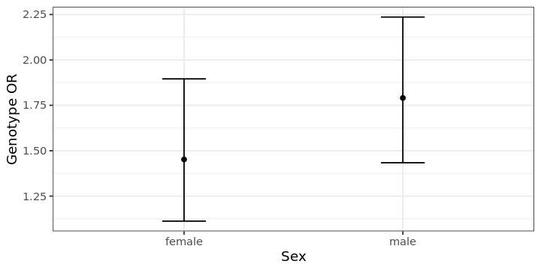
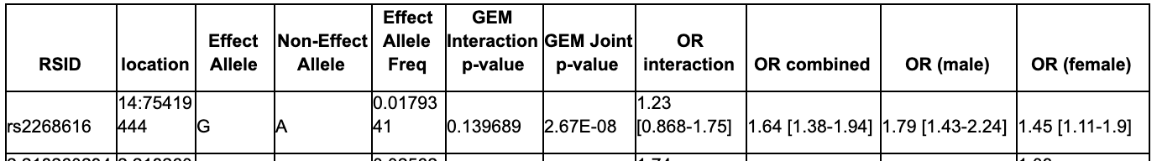
Greater Genetic Effect in Males (Rs2268616)
Notes:
Rs2268616 (PGF variant) was the most interesting we found and we will primarily highlight this variant
genome-wide significant variant in joint sex and joint cardiometabolic
Stratified sex analysis
Genetic effect in both female and males, but greater genetic effect in males

Slide 11
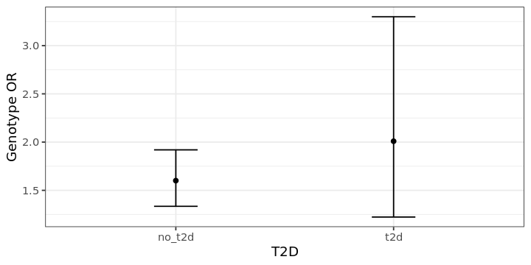
Greater Genetic Effect in T2D (Rs2268616)
Notes:
PGF variant has greater genetic effect in T2D, although our CI is larger.

Slide 12
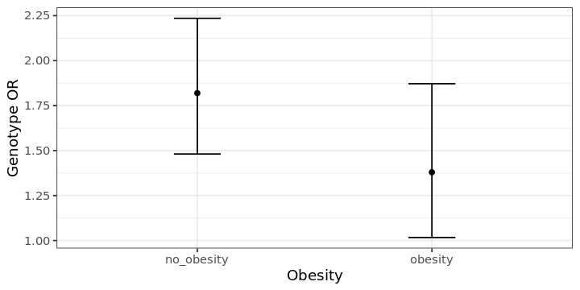
Greater Genetic Effect in No Obesity (Rs2268616)
Notes:
Interesting result: there was actually a greater genetic effect in no obesity.
Other variants did show a greater OR for obesity

Slide 13
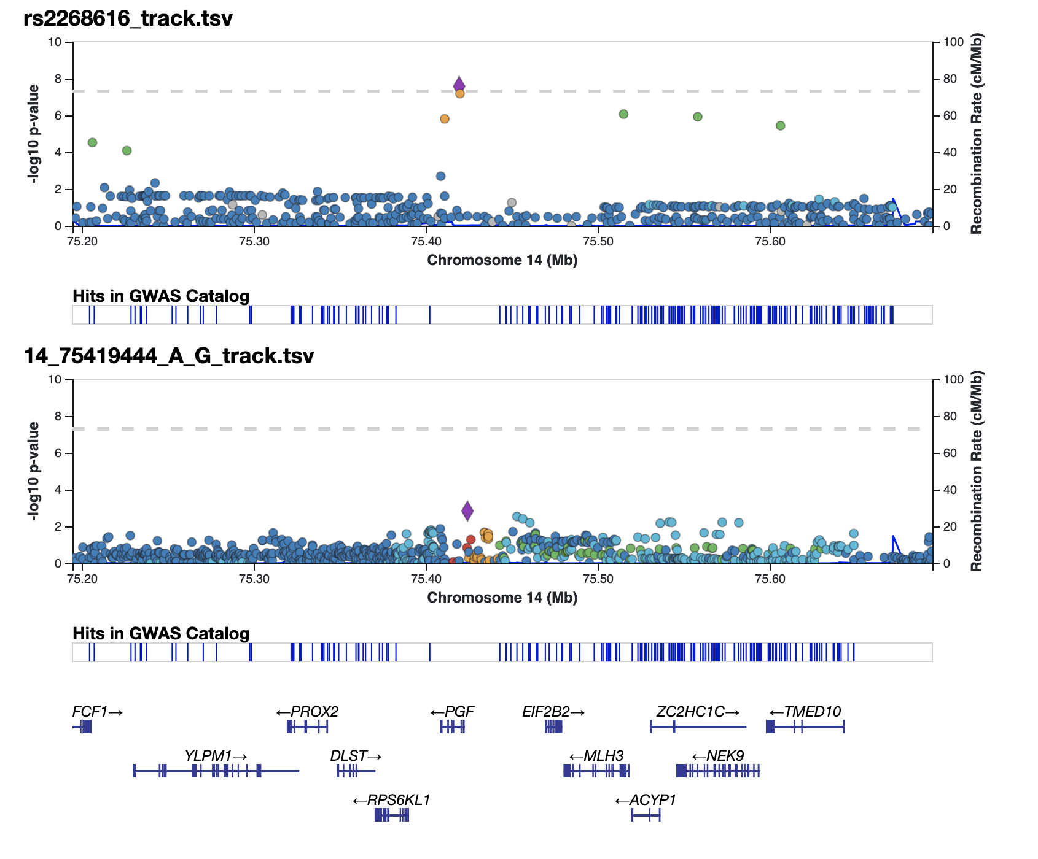
Comparison of Rs2268616 with HGI
GxE Joint
rs2268616
p_sex=2.67E-08
MAF=0.018
HGI Main Effect
rs2005863
p_HGI=0.001 MAF=0.0307
Notes:
HGI variant signal and we have nearby signals in our analysis; Gives us a little bit more confident in our findings
P value from HGI UKBB leave out

Slide 14
Findings
Five significant genomic regions (p < 5e-8)
Rs2268616 (PGF; Sex & CM Joint)
  Intron of PGF (sex dimorphic gene) & eQTL for EIF2B2 (viral mRNA translation)
  Strong transcription chromatin state in the lung, spleen, and B-cells among other tissues
  Sits within an enhancer in lung tissue, suggesting a modulatory role of this variant on transcription
  T2D knowledge portal: (+) Height, (+) CAD, (-) HOMA B
Notes:
genes and connection to COVID
PGF: placental growth factor; sex dimorphic gene
EIF2B2: Eukaryotic translation initiation factor
associated with viral mRNA translation!
Low tissue specificity: Medium protein translation in lung tissue and high translation in nasopharnyx and bronchus
Also premature menopause (sex differences)
50 kb away from PGF
CAD: coronary artery disease
HOMA beta: Homeostatic model assessment (HOMA) is a method for assessing β-cell function and insulin resistance (IR) from basal (fasting) glucose and insulin or C-peptide concentrations
Other notes:
MLH3
Thyroid hormones exert responses in various immune cells and have an important role in Inflammation, autoimmunity and pathogen Clearance. High gene expression in thyroid, which regulates various immune cells and pathogen clearance
perhaps mediating the robust inflammatory response in males
PGF (proteinatlas, gtex): where is this gene transcribed?

Slide 15
Findings
Rs11115199 (METTL25, CM int and joint)
eQTL relationship with METTL25, which is associated with BMI
Low transcription in CD8-positive, alpha-beta memory T cells and B cells
T2D KP associations: (+) T2D adjusted by BMI , (-) Obesity, (+) Weight
Rs182113773 (MACC1, CM joint)
Enhancer within neutrophil, monocyte, & B cell
High gene expression in EBV-transformed lymphocytes
RegulomeDB score: 0.58955 (0-1; 1 = regulatory variant)
Chr2:21826023 (DIRC, Sex joint)
eQTL for the DIRC transcript in sun-exposed skin
DIRC linked to body height, lean body mass, and bone density
Rs148793499 (CM joint)
Low transcription found in CD14-positive monocytes and lung fibroblasts
Stratified genetic effects show more associations in T2D (somewhat) and obese (strongly)
Notes:
Variants linked to regulation of immune response, as well as cardiometabolic status
Rs11115199: In the T2D KP (knowledge portal) show associations with (+) T2D adjusted by BMI (p=0.03), (-)Obesity (0.004), (+) Weight (p=.049); Predispose to T2D, but not against obesity
Higher risk of worse outcomes of COVID-19 may be mediated by:
Sex-associated differences in immune response &
cardiometabolic disease (T2D & obesity) comorbidities that deregulate immune response
which interact with the identified genetic variants.
Note: no significant variants for MDI. This mean there could be interactions but limited by study design
Smaller sample size//imprecise measurement of MDI or Imprecise way that it tracks SDH
OR MDI may not have interplay with genetics and have interactions for us to find

Slide 16
Conclusion
Leveraging this GxE interaction analysis uncovers novel variants and highlights biological mechanisms of interest
Our GxE interaction methods were able to uncover genetic effects previously unidentified
  GEM marginal p-value did not pass the genome-wide significant threshold (p<5e-08) for three of the five variants
Limited due to heterogeneity within our sample population (European ancestry).
Found novel sex dimorphic variants that provide a better understanding of COVID-19 biology and individuals at greater risk, as well as new direction for future studies!
Notes:
Subsetting our dataset to European ancestry (and England for MDI) reduces heterogeneity
Can’t leverage diversity within UKBB population
Future studies: susceptibility vs severity

Slide 17

Acknowledgements
Dr. Alisa Manning
Dr. Kenneth Westerman
Dr. Magdalena Sevilla Gonzalez
Analysis Therapy
Florez Lab
COVID Corps Internship

